Slide 1
Rollins Game Review Forum
By: Roles:
Desmond Nieves arrayDataMeister
Stephan Zambrano GUI_Scholar
PJ González GuyOnBackEndWithDaMethods
Notes:
Desmond works on arrayList for the review forums & their data
Stephan works on GUI implementation
PJ works on backend code methods & relations to ensure classes are properly coordinating with one another.

Slide 2
What did we want to make?
Our original idea was conceptualized as a Video Game User Review System, capable of doing three things:
System would process existing user review scores for a videogame
Categorize them into integer ranges from positive, mixed, & negative, outputting the overall average score for the game.
User is prompted to enter a new score (as int value) & then the system recalculates the metrics to account for the new review score.
Notes:
• Slide 2: Brief recap of your original concept and goals

Slide 3
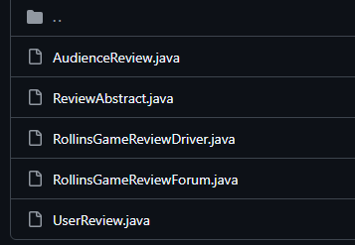
What do we have so far?
Since the first Progress Update:
Base Attributes, Getters, toString methods.
Abstract has elements used through reviewDriver
Driver class successfully implements new User review.
ReviewForum makes & updates review list.
Handles information for User’s review info (i.e. user ID, score, comment, etc.)
Notes:
• Slide 3: What you have accomplished since Progress Update #1

Slide 4
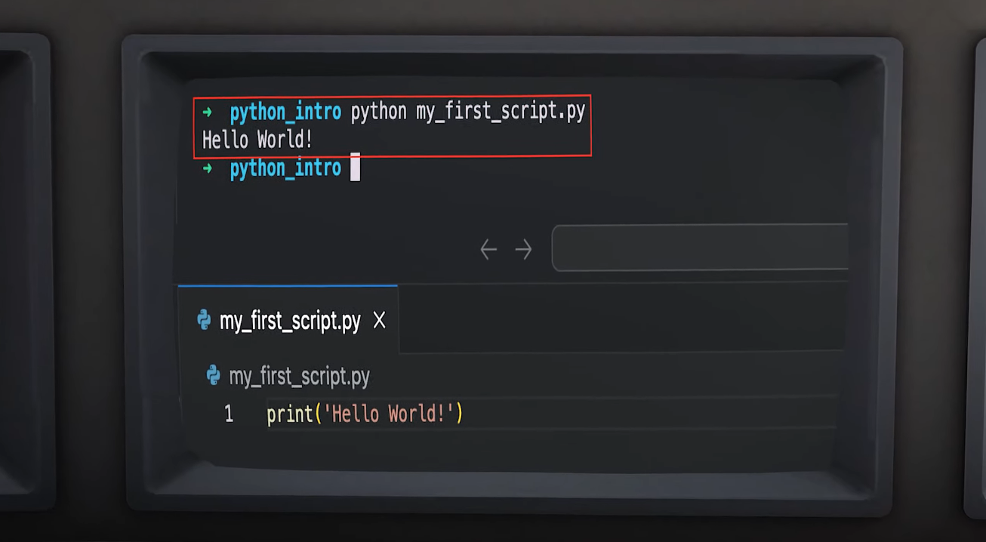

Demo Time
Pretend that’s not python
Notes:
• Slide 4: Demo your current workable version

Slide 5
What’s Left?
GUI // We’ve yet to start implementing GUI to program at large
  GameReviewForum will require significant change when implementing Graphics User Interface especially.
UserReview.java // methods submitReview() & displayReview are not defined
Placebo/totallyLegitReviewListWeDidntManufactureOurselvesTrustFrFr
  Visualizes what program would look like with enough use.

